Slide 1

Tallaght University Hospital

Slide 2
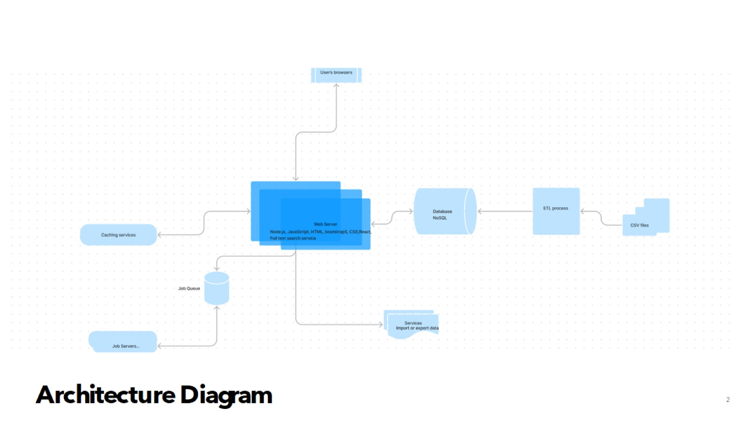
Architecture Diagram

Slide 3
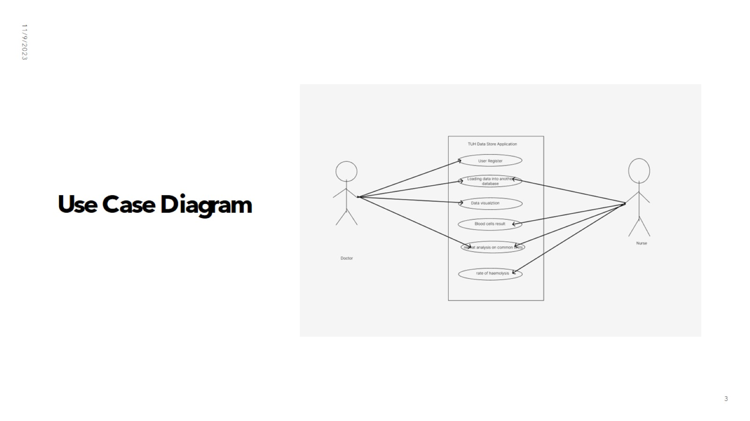
Use Case Diagram

Slide 4
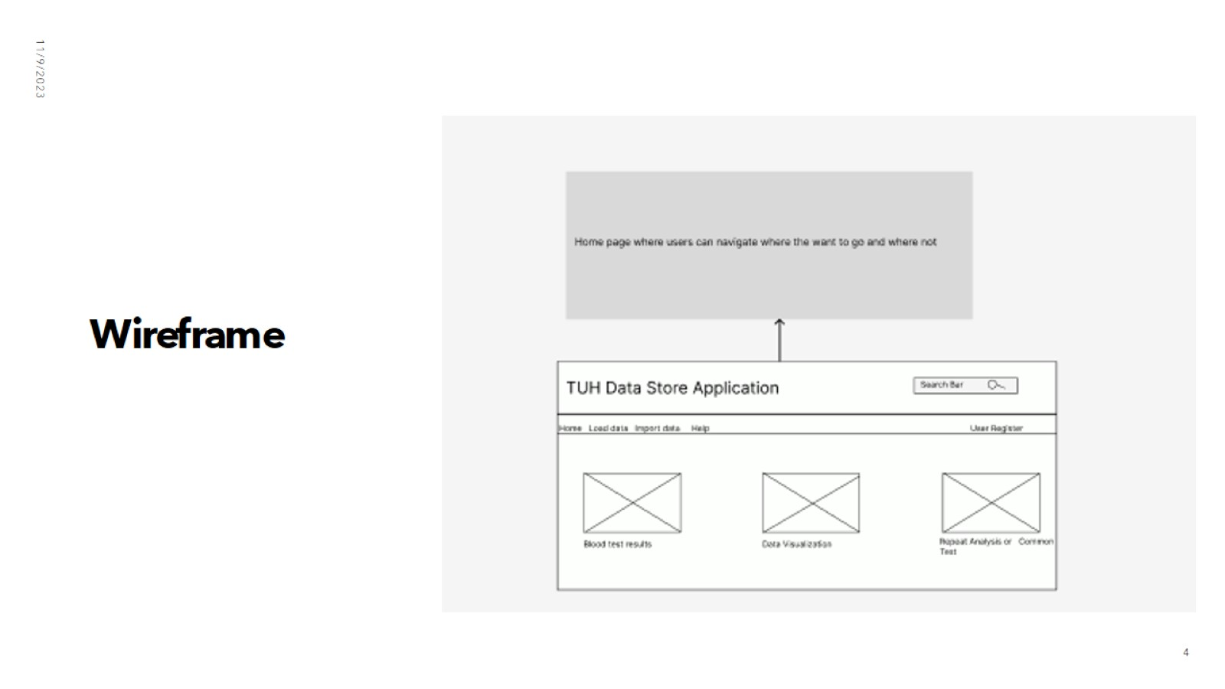
Wireframe

Slide 5
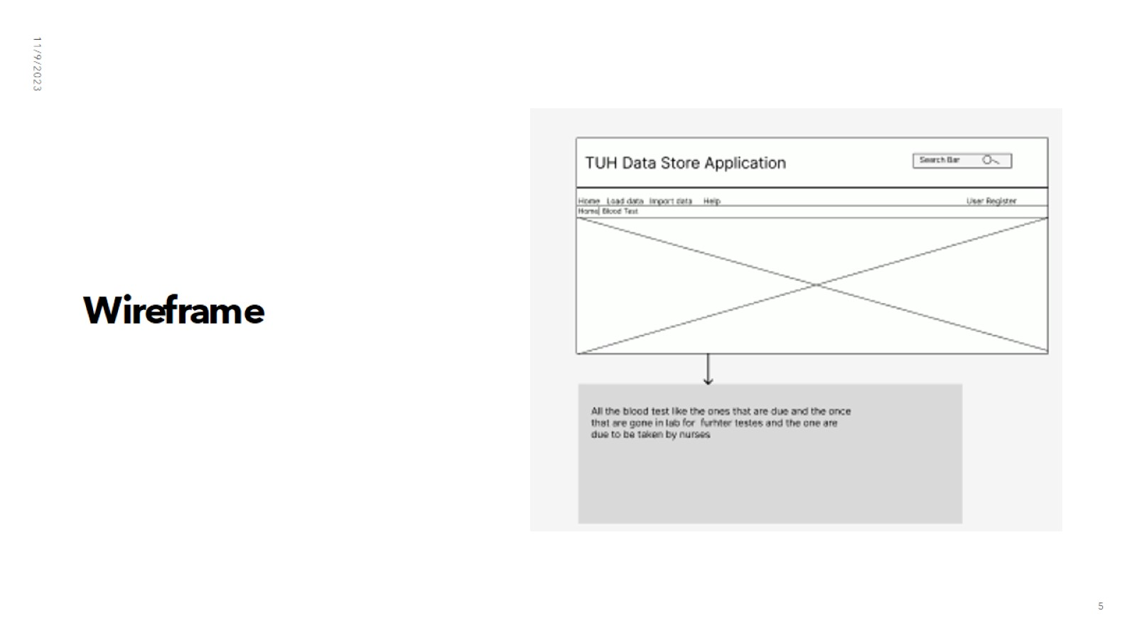
Wireframe

Slide 6
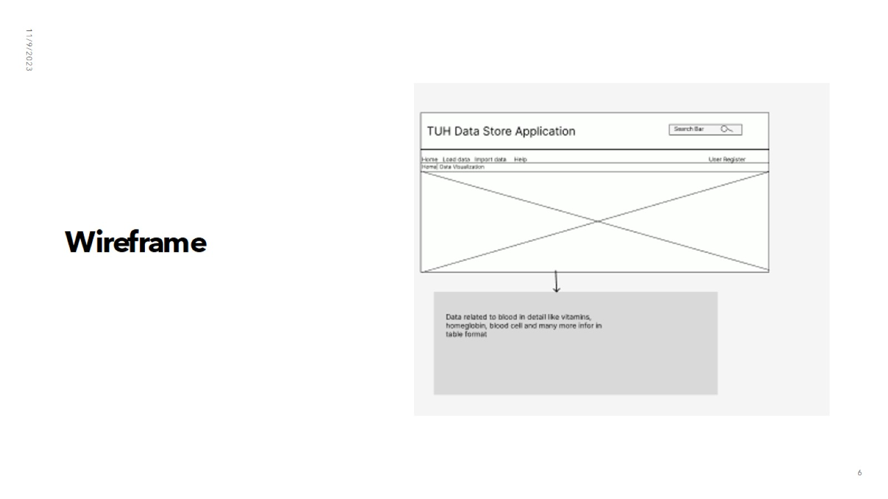
Wireframe

